Slide 1
AAKASH S
Final Project

Slide 2
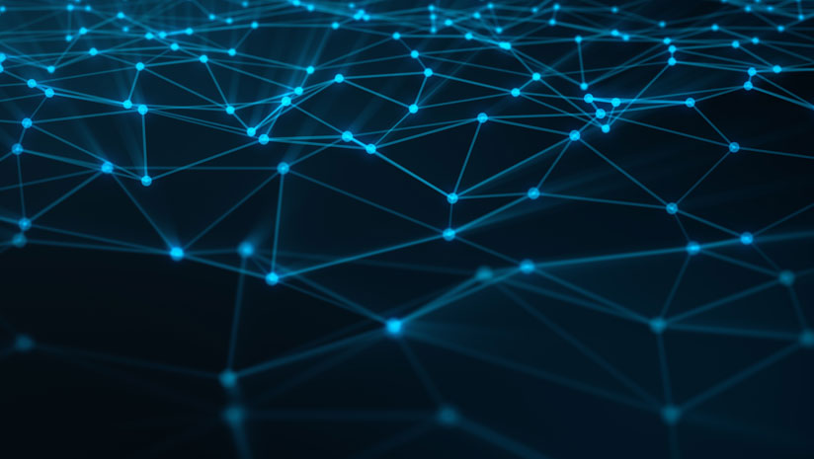
PROJECT TITLE
STYLE TRANSFER USING CNN
(VGG-16)

Slide 3


AGENDA
Style transfer is a technique in artificial intelligence and computer vision that involves applying the artistic style of one image (referred to as the "style image") to another image (referred to as the "content image"), resulting in a new image that combines the content of the latter with the artistic characteristics of the former. This process is achieved by leveraging deep neural networks to extract and manipulate the content and style features of the input images. The goal is to generate visually appealing images that exhibit the content of one image while adopting the artistic style of another, creating intriguing and often surreal visual compositions. Style transfer has applications in various fields, including digital art, image editing, and creative content generation.
3/21/2024 Annual Review

Slide 4

PROBLEM STATEMENT
The problem statement for style transfer is to create a new image that combines the content of one picture with the artistic style of another. For example, given a photo of a cat as the content image and a painting by Van Gogh as the style image, the goal is to generate a new image that looks like the cat but is painted in the style of Van Gogh. This involves finding a balance between preserving the content of the original image and applying the artistic characteristics of the style image.

Slide 5
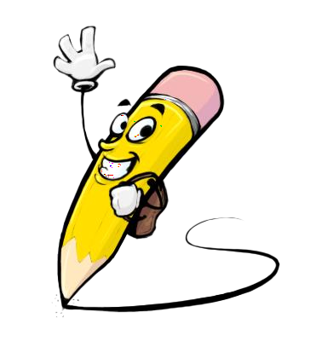
PROJECT OVERVIEW
The project overview is to create a style transfer algorithm that mixes the content of one image with the artistic style of another. We'll gather images for training, choose a deep learning model, define loss functions to measure differences, train the model, evaluate its performance, and then make it available for generating new artistic images. The goal is to produce visually appealing images that blend content and style seamlessly.

Slide 6
WHO ARE THE END USERS?
Artists and Designers: Artists and designers who are looking for tools to generate unique and creative images with specific artistic styles.
Photographers: Photographers who want to apply artistic styles to their photos to create visually striking compositions.
Content Creators: Content creators in fields such as advertising, marketing, and entertainment who need visually appealing images for their projects.
General Public: Individuals who are interested in exploring artistic expression or enhancing their photos with different styles for personal enjoyment or sharing on social media platforms.
Researchers and Developers: Researchers and developers who are working on further advancements in style transfer algorithms or integrating them into other applications and platforms.

Slide 7

YOUR SOLUTION AND ITS VALUE PROPOSITION
The solution is a style transfer algorithm that seamlessly blends the content of one image with the artistic style of another, resulting in visually appealing and unique compositions. Our algorithm offers several key value propositions:
Creativity and Versatility: Users can unleash their creativity by transforming ordinary images into extraordinary artworks with various artistic styles, ranging from classic paintings to modern art.
Ease of Use: The algorithm provides an intuitive and user-friendly interface, making it accessible to both novice and experienced users without requiring advanced technical skills.
Customization: Users have the flexibility to adjust parameters and fine-tune the style transfer process according to their preferences, allowing for personalized and tailored results.

Slide 8

THE WOW IN YOUR SOLUTION
The wow factor in our solution is its remarkable ability to effortlessly transform ordinary photos into extraordinary artworks in just seconds. With a simple click, you can choose from a diverse range of artistic styles or even craft your own, allowing for endless creative exploration. Whether you're a seasoned artist or someone who simply appreciates beauty, our user-friendly interface ensures that everyone can create stunning images that will captivate and inspire. Say goodbye to complex editing tools and hello to instant artistic transformation with our innovative solution.
3/21/2024 Annual Review

Slide 9
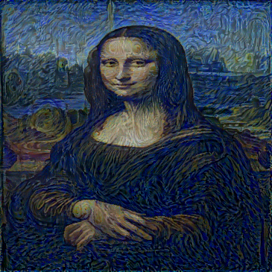
MODELLING
Teams cam add wireframes
Using the VGG-16 model for style transfer involves these main steps:
Extract Features: Use VGG-16 to understand the content and style of input images.
Define Loss Functions: Create rules to measure how close the generated image is to the content and style images.
Optimize: Adjust the generated image to minimize differences in content and style.
Fine-tune Parameters: Adjust settings like learning rate to improve the outcome.
Evaluate: Check the quality of the result using different measures.

Slide 10
RESULTS
The outcome is a sophisticated tool leveraging the VGG-16 model, allowing users to seamlessly convert images into stunning artworks. Its user-friendly interface facilitates exploration of diverse artistic styles, while fast processing guarantees prompt results without sacrificing quality. This versatile solution caters to users of all skill levels, promising a delightful and fulfilling creative experience.
Demo Link
https://github.com/aakash0132/TNSDC-Generative-AI

